Slide 1


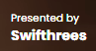
from charts to hearts.
using data science to boost mrld‘s Spotify presence
Notes:
Hi everyone, we are Swifthrees, a data science consulting firm. We help clients make informed decisions by analyzing and interpreting data.
Last week, Kean Cipriano, the founder of O/C Records, reached out to us saying “Guys, I want one artist under my record label to do well on Spotify’s Philippines Daily Top 200 Chart. You have freedom to select whoever that artist is. Just provide me with strategies to improve his/her ranking.”
And as a team of competent data scientists, we took the challenge. Eventually, we determined mrld as the artist we’d like to help. With that, the theme of our pitch is bringing mrld from charts to hearts, utilizing data science to discover actionable insights, making her an artist that is streamed by many Filipinos.

Slide 2




Getting to Know the Chosen Artist
from charts to hearts
getting to know
Meriel de Jesus | mrld
signed under O/C Records
An Art Gallery Could Never Be As Unique As You
Notes:
First, let’s get to know mrld. mrld is a mononym of her name, Meriel de Jesus. She gained mainstream popularity soon as she dropped her debut track “An Art Gallery Could Never Be As Unique As You” under O/C records in 2021.

Slide 3
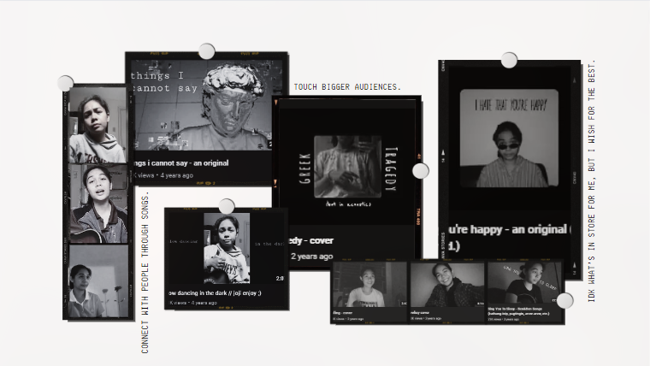
Getting to Know the Chosen Artist
from charts to hearts
Notes:
What’s interesting is prior joining O/C Records she’s been on her journey as early as 14 years old, releasing music on YouTube: originals and covers alike

Slide 4


Why mrld?
from charts to hearts
Notes:
But why select ‘mrld’ in the first place?
Kean mentioned he’d like someone from his label to flourish on Spotify’s Philippines Daily Top 200 Chart. So we went ahead and collected chart data as early as January 2017 to the most recent which was October of this year.
The dataset we compiled contained more than 1,000 unique artists, both foreign and Filipino.
And so, filtering the dataset is imperative. We came up with 4 criteria, and mrld checks all the boxes.

Slide 5

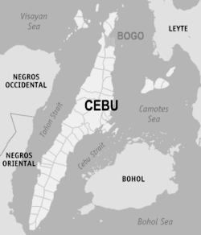
Why mrld?
from charts to hearts
Filipino
Notes:
1st: the artist should be Filipino since O/C Records roster are limited to local talents atm -> mrld is a Filipina singer-songwriter based in Cebu

Slide 6
Why mrld?
from charts to hearts
mainstay
684
1.4k
days
appearances
Notes:
2nd: the artist should be mainstay
-> since entering on December 2021, mrld hasn’t fell off the Top 200 Chart
-> she established an incredible feat, having an ongoing streak of 684 days with over 1.4 thousand number of appearances, meaning, there are days where multiple songs of her made it to the chart

Slide 7



Why mrld?
from charts to hearts
has charting tracks
released not more than 5 years ago
21Mn
76Mn
42Mn
An Art Gallery…
Ligaya
Ikaw Pa Rin
2019
2021
2022
Notes:
and Lastly: the artist should not be a one-hit wonder…the artist should possess multiple tracks that made it to the chart…also, those charting tracks should have a release date not more than 5 years ago to ensure artist’s relevancy…that is, the artist is not charting because of an old song released from way-way back
-> so, mrld has 13 songs, and 3 of those made it to the chart, namely:
An Art Gallery Could Never Be As Unique As You,
Ligaya, which was released in October 2021…this is actually her highest-streamed track with over 76Mn total streams to-date, and Ikaw Pa Rin

Slide 8
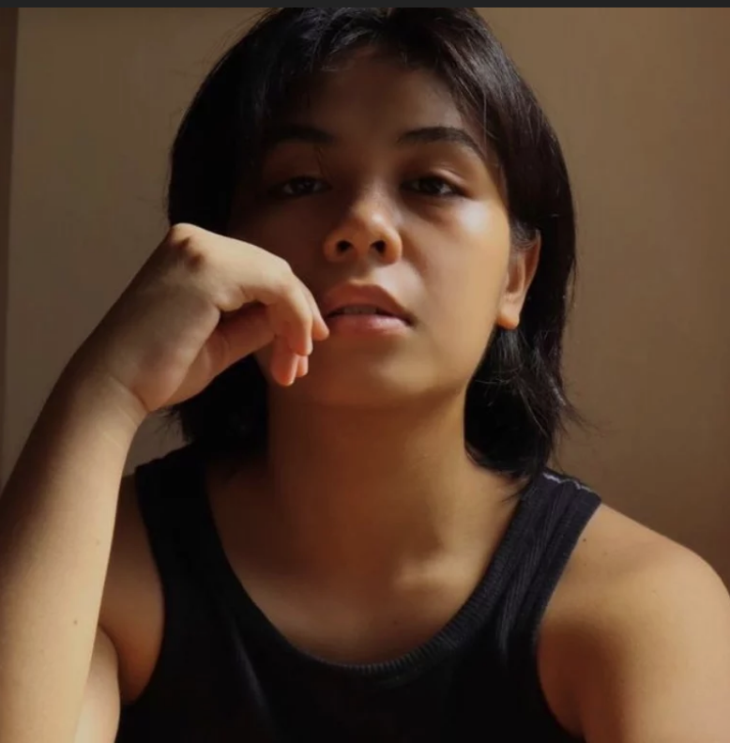
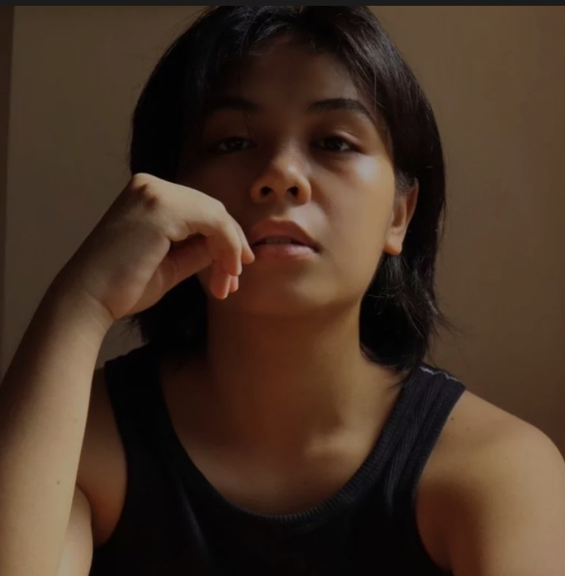
Problem Statement
from charts to hearts
"How can we make mrld a top Spotify pinoy artist?"
m
m
r
r
l
l
What specific audio features should her songs have?
When should she release her music?
Which artists should she collaborate with?
What would be an ideal Spotify playlists for her?
d
d
Notes:
And that brings us to our problem statement. How can we make mrld a top Spotify pinoy artist? We can solve that problem by asking the following questions:
What audio features should her songs have?
When should she release her music?
Which artists should she collaborate with?
What would an ideal Spotify playlists for her look like?
But before we try to answer these questions, let’s take a step back and zoom out on the PH Spotify industry first.

Slide 9
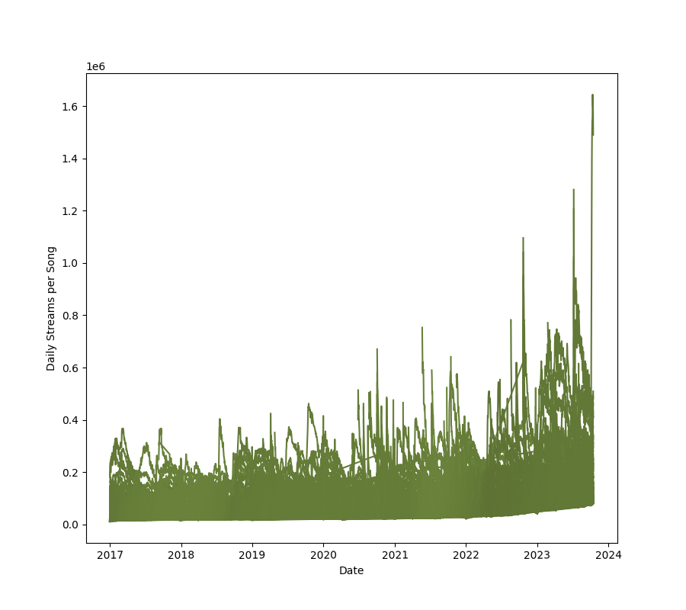
Landscape: PH Daily Top 200s
from charts to hearts
1.6Mn
4x harder
to top, but songs also top higher
A hit song in 2017 would’ve peaked at around 400k daily streams. A hit song in 2023 can hit as high as 1.6 Mn streams a day.
400k
Notes:
Interestingly, it’s now actually 4x harder to make a hit song than it was in 2017, but when a song hits now, it also hits 4x harder. Previous peeks were around the 400k mark but today a top song can hit as high as 1.6Mn streams a day. You might be wondering what that song is, it’s actually…

Slide 10


Artist with highest daily stream in 2023
From hearts
to 1.6Mn a day in the charts
ERE by juan karlos
The artist’s rumored breakup song with model ex-girlfriend skyrocketed to 1.6 Mn daily streams in October 2023.
2023
Notes:
ERE by Juan Karlos. His rumored breakup song with model ex-girlfriend, Maureen Wrobblewitz. And JK isn’t the only pinoy artist in the top.

Slide 11

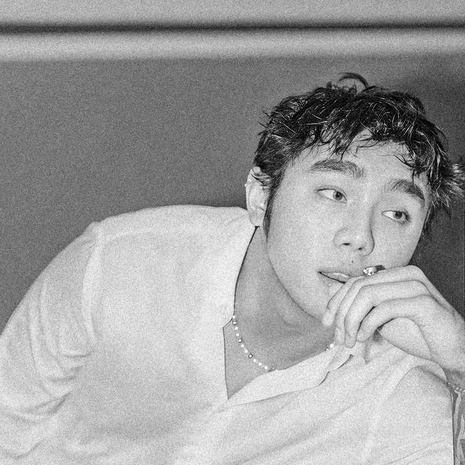
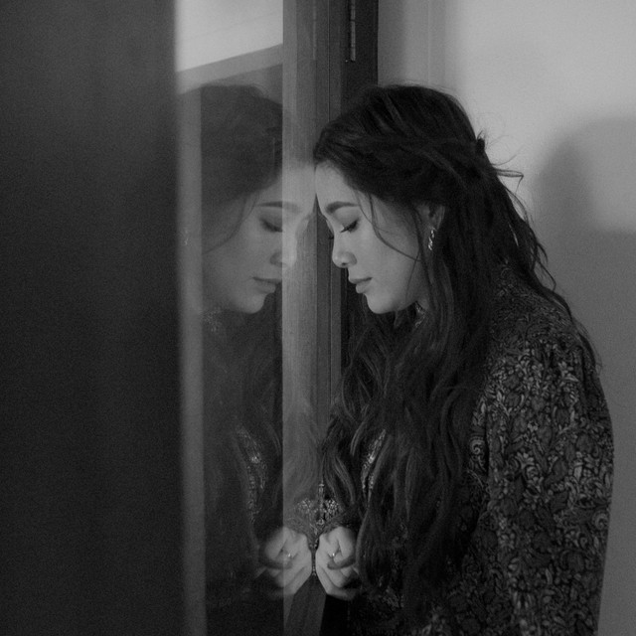
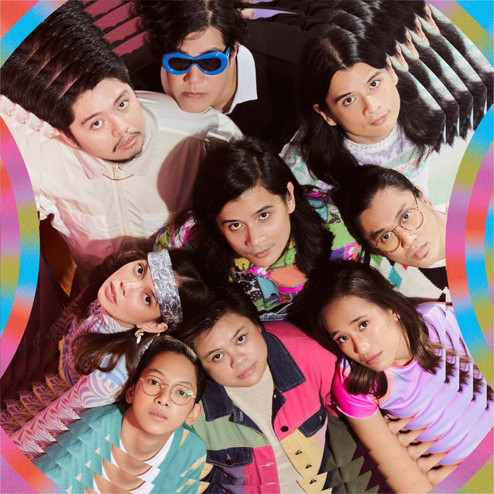



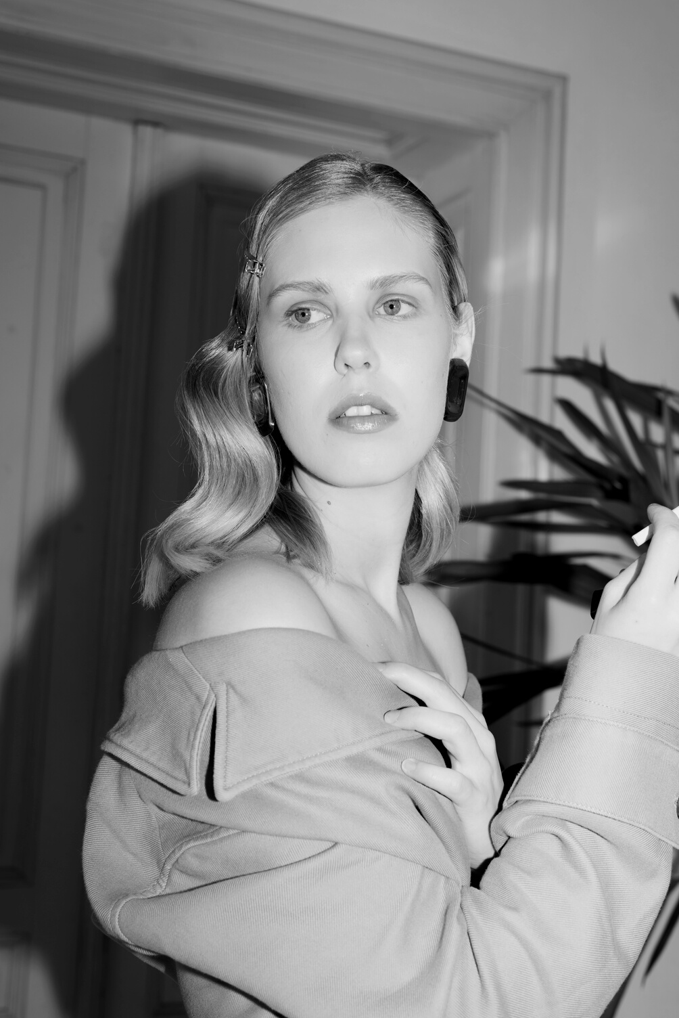







Top 10 Pinoy Artists
from charts to hearts
Collectively, these top pinoy artists have…
4.9 Bn streams
Ben&Ben | Zack Tabudlo | Moira
December Avenue | Arthur Nery | Adie
Nobita | Silent Sanctuary | IV of Spades | Hale
Notes:
Artists like Ben&Ben, Zack Tabudlo, Moira and others collectively already have around 4.9 Bn Streams on Spotify! A way to boost streams for mrld is actually to…

Slide 12
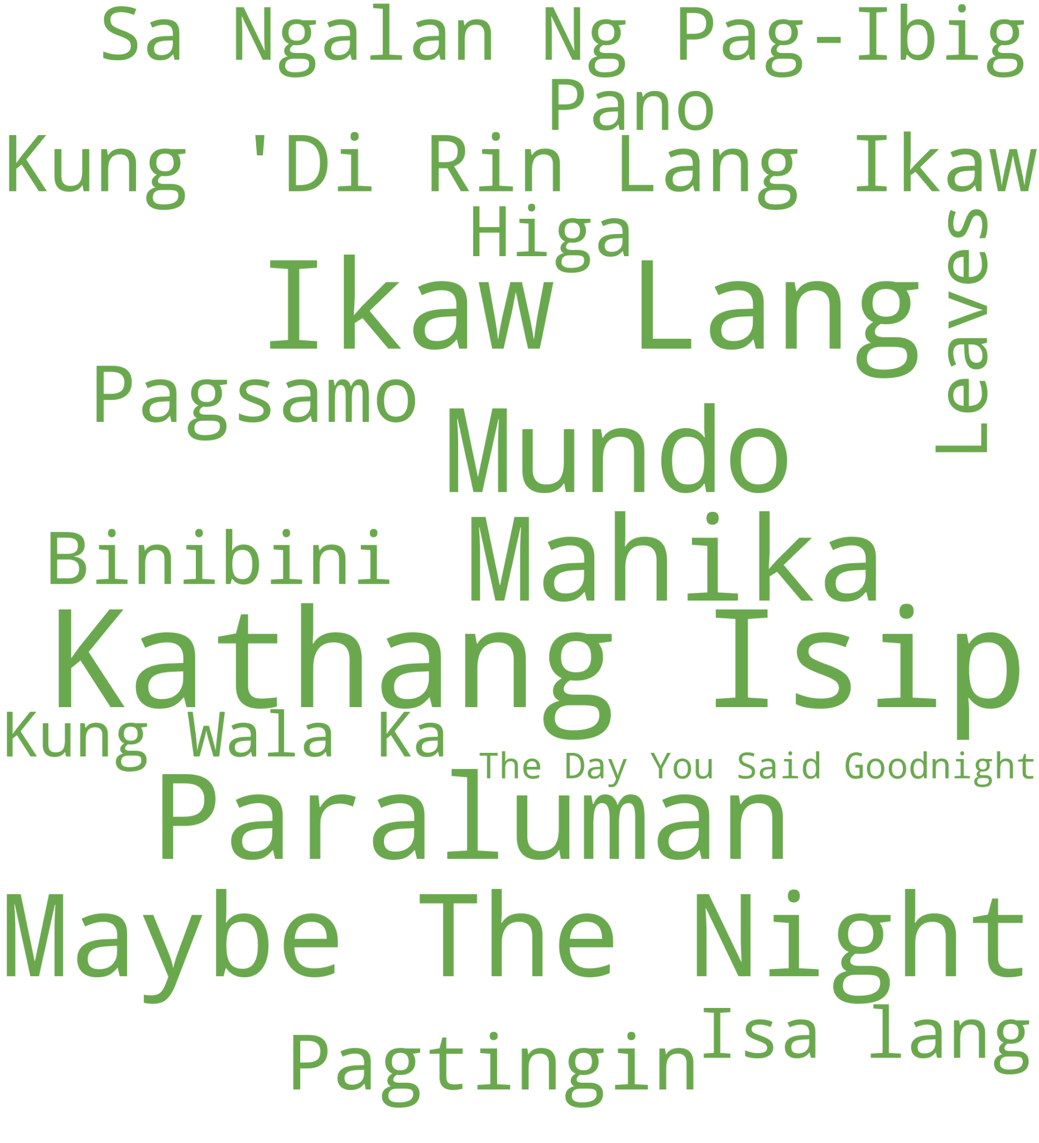
Songs from PInoy artists with highest total treams
from charts to hearts
OPTION A:
Learning from the top
Is there a pattern we can see from the top Pinoy songs and artists?
Notes:
learn from the Top. From our EDA, we garnered the following key insights:

Slide 13

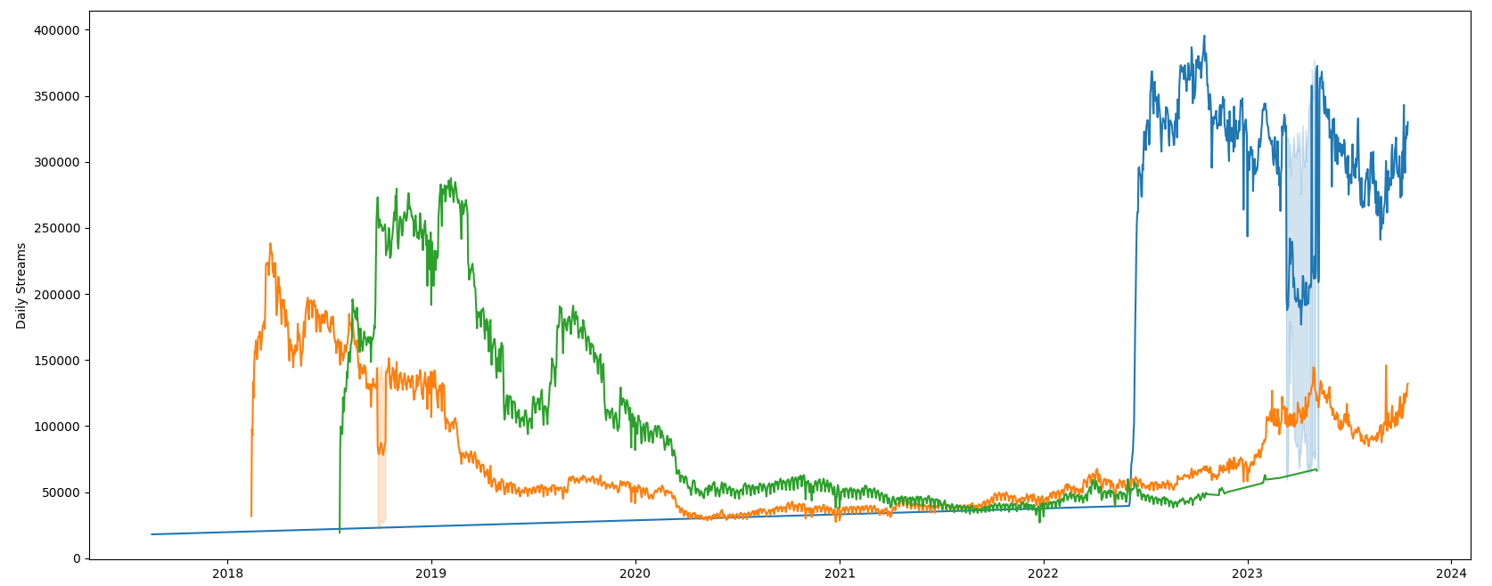





Strategy 1: Engage with your audience & create hype
Top songs also experience dips but top artists strategically scatter their events to engage with their audience and create hype. This prolongs the life of a song on the charts.
Sigla Music and Arts Festival
Mundo by IV of Spades
Music
Video
Kung ‘Di Rin Lang Ikaw by December Avenue ft. Moira
Mahika by Adie & Janine Berdin
March 2018
Wanderland
Music
Video
Festivals
Me and My
Mundo Trend
Kung ‘Di
Rin Lang
Ikaw
Notes:
First, Top songs also experience dips (which is expected from any kind of product) but top artists strategically scatter their events to counter those dips. They either sing at a festival, release a music video, join a trend or sing on Wish 107.5. These strategies keep their audiences engaged and their songs in the charts.

Slide 14

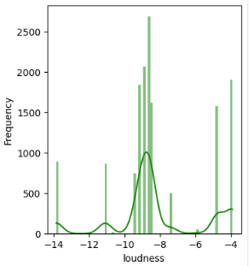
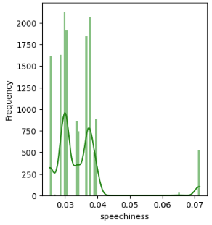
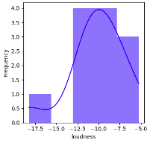
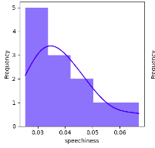
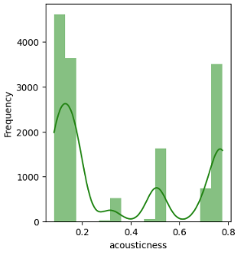
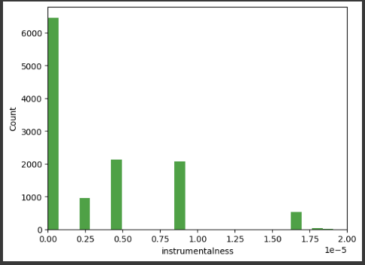
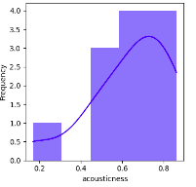
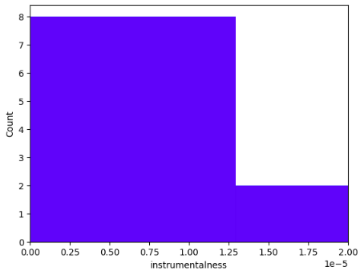

Strategy 2: Go with the audio flow
Release songs that have similar audio features to songs of top pinoy artists. In this case, decrease loudness, speechiness, acousticness and instrumentalness of mrld songs.
Songs of Top Pinoy Artists
Spotify song of mrld
Notes:
Slide 14: Another strategy is to study the audio features of top OPM songs. Which have certain pattern to their loudness, speechiness, acousticness and instrumentalness. Overall mrld can use these patterns as a blueprint for future song releases.

Slide 15
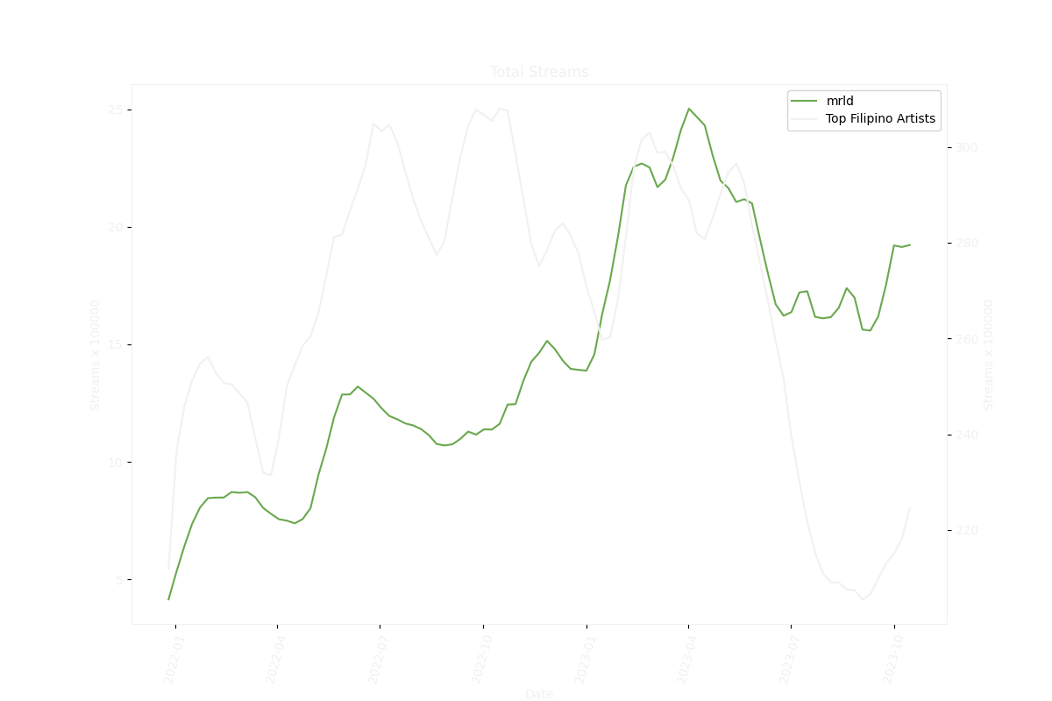
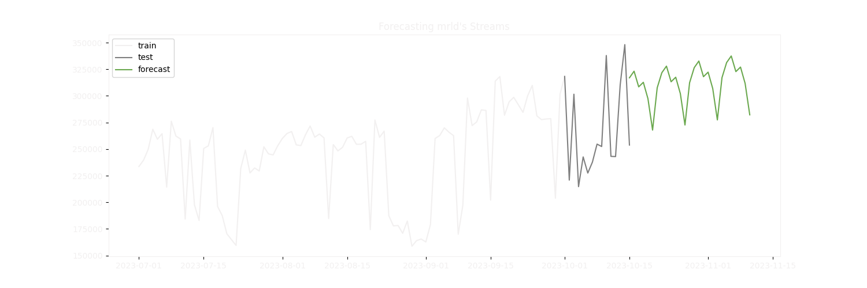
Songs from PInoy artists with highest total streams
from charts to hearts
OPTION B:
Time
song releases
Avoid releasing songs during periods when top Pinoy artists release their songs
Notes:
-we weren't able to find general seasonality trends on the number of streams of the top filipino artists
-its hard to predict when each artist will put out new music or when their music will have a sudden surge in streaming
- we found that mrld is still trending upwards, while the top artists, collectively, are trending down the past few months.
- it may be wise to take action soon and release new music or get mrld’s name out there while competition is slightly lower within the market.
- preferably within quarter 1 of 2024 would be preferred to take advantage of the lull within the industry
-march 2023 to may 2023 were the biggest months for mrld in terms of streaming, months where the top filipino artists' streams began to take a dip.
- using an exponential smoothing model, we tried to forecast mrld's streams for the coming month, we forecast that her streams will remain steady given no big changes happen

Slide 16
Machine Learning to boost Spotify streams
from charts to hearts
USING DATA SCIENCE:
Random
Forest
Classifier
01
02
03
Created the Training Set
Train: Genre
Classification
Applied to Top Pinoy Songs
Used spotipy to extract specific OPM playlists from Spotify. Genre label is extracted from the playlist name.
Trained a Random Forest Classifier model using audio track features.
Applied the trained model to a dataset containing the songs of Pinoy artists in the PH Daily Top 200s.
Genres:
OPM rock
OPM rap
OPM P-pop
OPM senti
Playlists used:
OPM Rock Hits 808K followers
Kalye Hip-hop 973K followers
P-pop On The Rise 172K followers
OPM Says Chillax 1.6M followers
ACCURACY: 77%
Notes:
Apart from timed song releases, we wanted to find out potential artists she can collaborate with.
Moreover, the list should be realistic and doable. Not taylor Swift nor Drake. In doing so, we have performed this methodology:
Remove all foreign artists from the dataset. This ensures the recommendation engine shows only songs from local artists
Classify OPM into 4 distinct genres. We classified the genres into rock, rap, p-pop and senti; this is to have clearcut and defined genres.
Choose playlists containing tracks that best represent each genre sound. Choosing the right playlist ensures we get high scores for both Evaluation Metrics and Model Performance. We ended up choosing Spotify-made playlists for credibility. We also chose playlists with high volume followers.
Train a Model for Genre Classification. Due to having a good set of playlists, we only had one duplicate song. Moreover, we have achieved good metric scores and good model performance via use of gridsearch. From all the models, our best performing is the Random Forest Classifier.

Slide 17



Songs from PInoy artists with highest total treams
from charts to hearts
OPTION C:
Know who
to collaborate
with
0.000004
December Avenue
0.000004
Seed track: Ligaya by mrld
Using cosine distance, seed track’s similarity was then calculated against other songs based on the audio features and the predicted genre probabilities.
Belle Mariano
0.000005
Notes:
Next. We ran the model to create a recommender engine pool through our pinoy-filtered dataset. Here we got an average predicted_genre_proba of 61%. That means, our model was able to adequately classify genres.
Finally, to our recommender engine. We used the song Ligaya as seed track, being her best streamed song. From all the builds, it was Build 4 (cosine features + predicted genre probabilities) that has the best set of recommended songs to our seed track.
Based on our findings, the top three recommended artists for MRLD to collaborate with are December Ave, followed by Join the Club, and Belle Mariano.

Slide 18
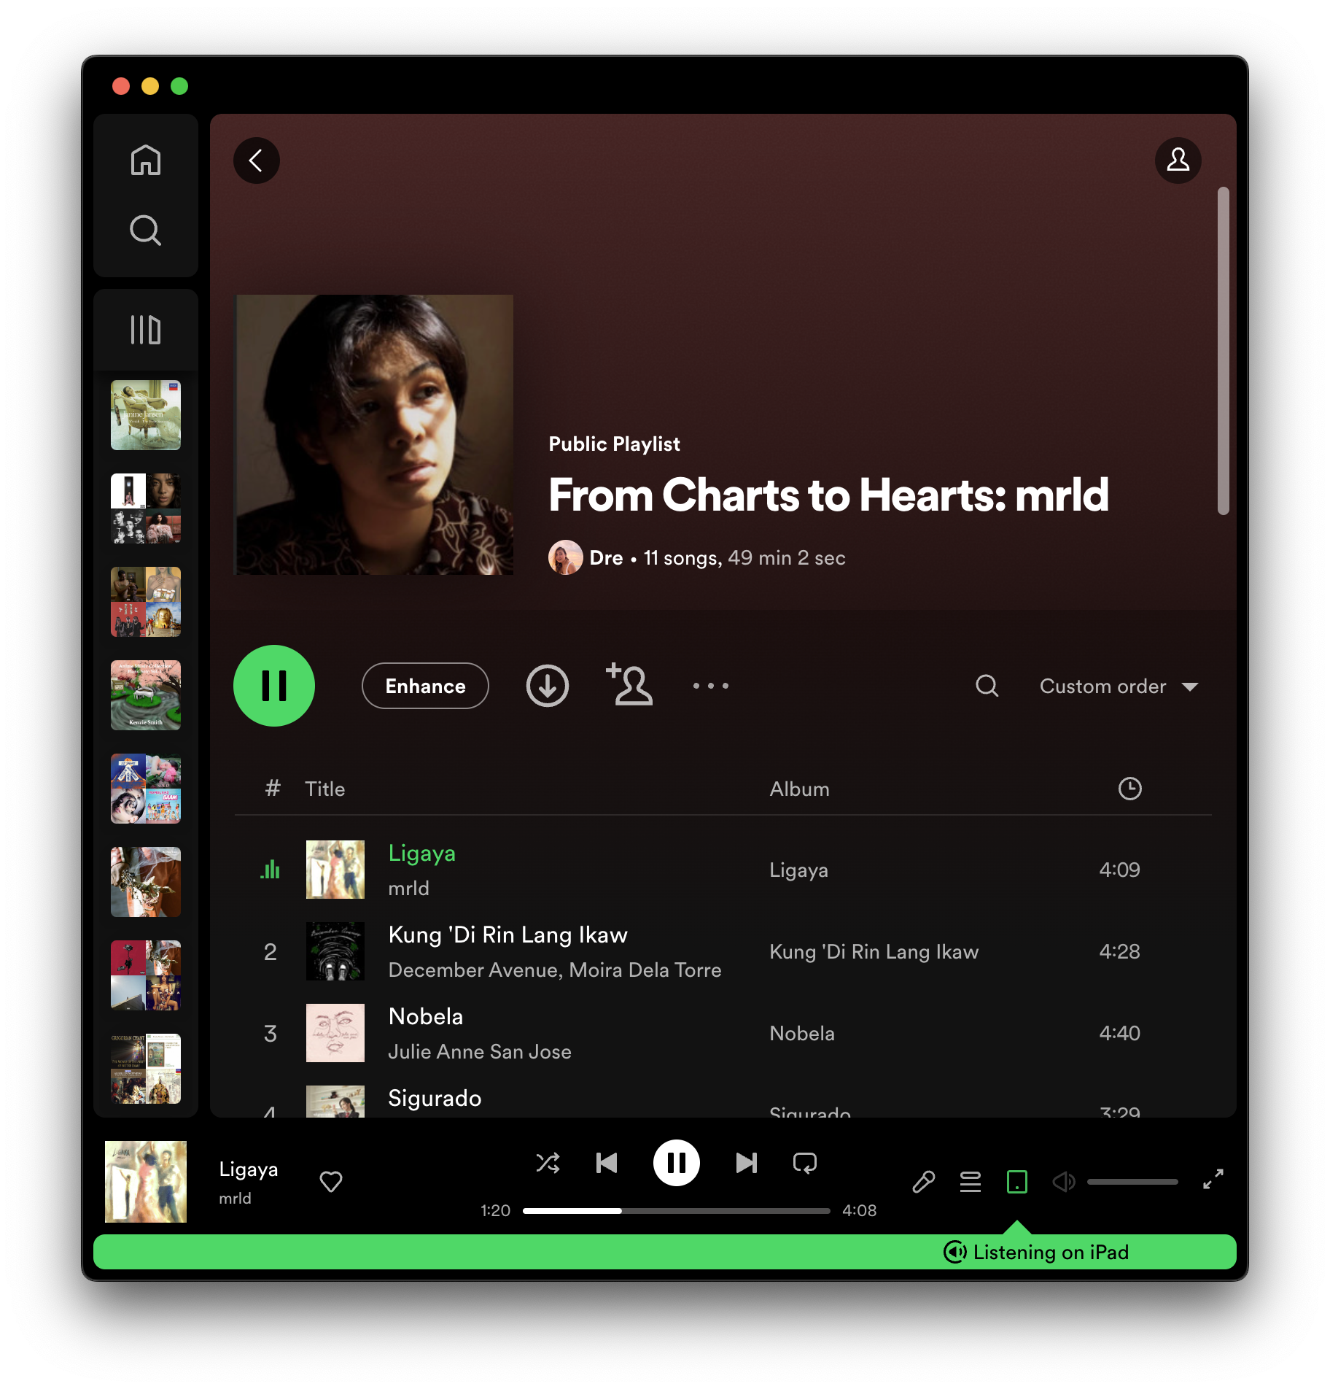

Songs from PInoy artists with highest total streams
from charts to hearts
OPTION D:
Include in
playlists with
top pinoy artists
Recommender Engine using cosine distance and built on similar audio track features and predicted genre probabilities (genre trained with Random Forest Classifier)
Open your Spotify app and scan
this code to listen to our playlist!
Notes:
Apart from recommended artists to collaborate with, we have also used this model to determine a playlist containing chart topping songs similar to MRLD’s Ligaya. This is with the intention, that fans of those other artists may get to know her.
Our playlist From Charts to Hearts is now available… in Spotify.

Slide 19

IN
SUMMARY
from charts to hearts
01.
Strategically scatter mrld events/trends (concerts, music videos, Wish 107.5, Tiktok, etc.) to counter dips in streams. This prolongs the life of a song on the charts.
m
r
02.
Decrease loudness, speechiness, acousticness and instrumentalness of mrld songs. To mimic the audio features of top pinoy songs.
l
03.
Take advantage of the popularity of mrld now and release songs within the 1st quarter of 2024. Also takes advantage of quiet season for top artists.
d
04.
Collaborate on songs with December Avenue, Join the Club and Belle Mariano
>>>
Notes:
[Abdul] In summary, here are our recommendations:
First, strategically scatter mrld events/trends to counter dips in streams because this prolongs the life of a song on the charts.
Second, decrease the loudness, speechiness, acousticness, and instrumentalness of mrld songs to mimic the audio features of top pinoy songs.
Third, take advantage of the popularity of mrld now and release songs within the 1st quarter of 2024.
Next, collaborate on songs with December Avenue, Join the Club and Belle Mariano.

Slide 20
IN
SUMMARY
from charts to hearts
05.
Include in playlists with top pinoy artists that have similar audio track features and predicted genres. Take advantage of social media and get on to creative playlists as well.
m
r
06.
All of mrld’s songs right now are singles. In the future, it might be a good strategy to release an album.
l
07.
mrld is a hit in Indonesia. Consider branching out to the Indonesian market.
Source: https://mb.com.ph/2023/02/13/o-c-records-mrld-breaking-barriers-in-indonesia/
d
***
Notes:
Also, include in playlists with top pinoy artists that have similar audio track feature and predicted genres.
It also might be a good strategy to release an album because all of mrld’s songs right now are singles.
And finally, mrld is a hit in Indonesia. So, we might consider branching out to the Indonesian market.

Slide 21
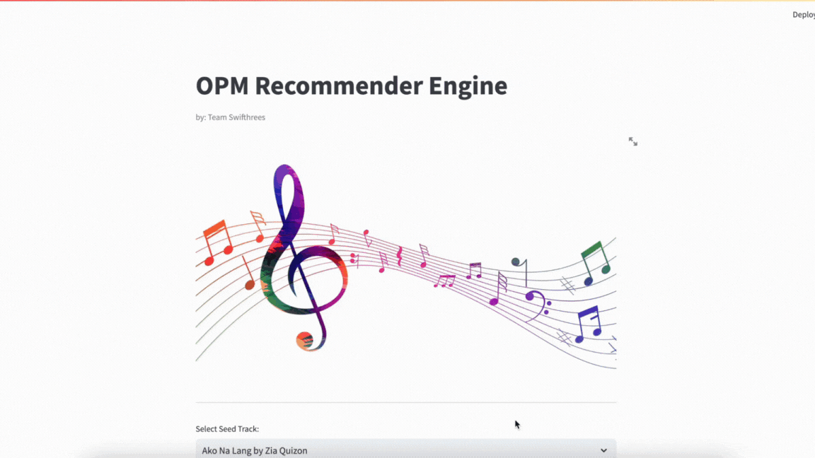
Streamlit App
from charts to hearts
Notes:
Lastly, here’s a preview of the simple Recommender Engine streamlit app that we made. It accepts a seed track from our OPM dataset then the app will display the seed track’s predicted genre that is generated from our ML model and the recommended songs based on the Cosine similarity method using the seed track audio features.

Slide 22
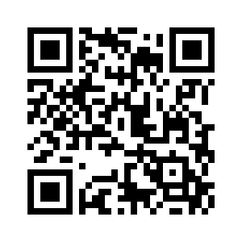
Streamlit App
from charts to hearts
Scan the QR Code to access our Streamlit App!
From charts to hearts. Using Data Science to boost mrld‘s Spotify presence
Thanks for listening!

